Slide 1

CAP950 OPEN SOURCE TECHNOLIGIES (PHP)

Slide 2
Working with graphics in PHP
embedding an image in web page using php,
creating and drawing images,
images with text, scaling images,
color handling of images using PHP

Slide 3
embedding an image in web page using php
The Content-Type header is used to indicate the media type of the resource. The media type is a string sent along with the file indicating the format of the file. For example, for image file its media type will be like image/png or image/jpg, etc.
<?php
header('Content-type: image/jpeg');
echo file_get_contents("nature.jpg");
?>

Slide 4
file_get_contents() function
The file_get_contents() function in PHP is an inbuilt function which is used to read a file into a string.
<?php echo file_get_contents(“file.txt"); ?>

Slide 5
Basic approach:
<!DOCTYPE>
<html><head><title></title></head>
<body>
<?php
$image_url='nature.jpg';
?>
<img src="<?php echo $image_url;?>">
</body></html>

Slide 6
Display all images from your file
<?php
foreach (glob("*.jpg") as $filename)
{
echo "<img src='$filename' alt='$filename' height='50px' />"."<br>";
}
?>
The glob() function returns an array of filenames or directories matching a specified pattern.

Slide 7
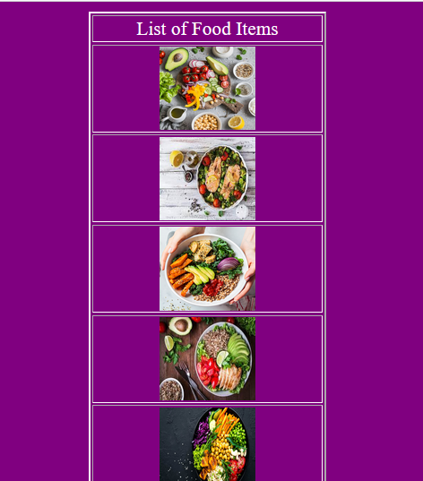

Slide 8
imagecreate() function
The imagecreate() function is an inbuilt function in PHP which is used to create a new image. This function returns the blank image of given size.
Syntax:
imagecreate( $width, $height )

Slide 9
imagecreatetruecolor() Function
The imagecreatetruecolor() function is an inbuilt function in PHP which is used to create a new true-color image. This function returns a blank image of the given size.
Syntax:
resource imagecreatetruecolor( $width, $height )

Slide 10
imagecolorallocate() function
The imagecolorallocate() function is an inbuilt function in PHP which is used to set the color in an image. This function returns a color which is given in RGB format.
Syntax:
int imagecolorallocate ( $image, $red, $green, $blue )
$red: This parameter is used to set value of red color component.
$green: This parameter is used to set value of green color component.
$blue: This parameter is used to set value of blue color component.

Slide 11
imagefill()
The imagefill() function is an inbuilt function in PHP which is used to fill the image with the given color.
Syntax:
bool imagefill( $image, $x, $y, $color )

Slide 12
imagestring() function
The imagestring() function is an inbuilt function in PHP which is used to draw the string horizontally. This function draws the string at given position.
Syntax:
bool imagestring( $image, $font, $x, $y, $string, $color )

Slide 13

<?php
$img = imagecreatetruecolor(500, 300);
$color = imagecolorallocate($img, 155, 250, 280);
imagefill($img, 0,0,$color);
header("Content-Type: image/jpeg");
imagepng($img);
?>

Slide 14
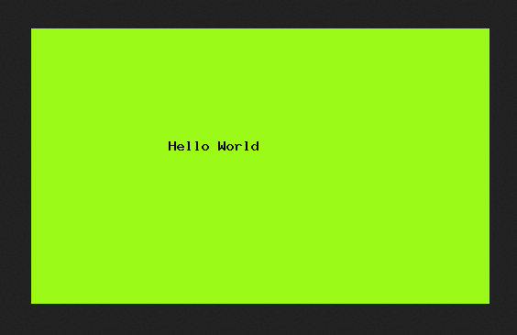
By using imagecreate(), imagecolorallocate(), imagestring()
<?php
$img = imagecreate(500, 300);
$bgcolor = imagecolorallocate($img, 150, 200, 180);
$fontcolor = imagecolorallocate($img, 120, 60, 200);
imagestring($img, 12, 150, 120, "Demo Text1", $fontcolor);
header("Content-Type: image/png");
imagepng($img);
imagedestroy($img);
?>

Slide 15
imagerectangle()
The imagerectangle() function is an inbuilt function in PHP which is used to draw the rectangle.
The imagefilledrectangle() function is an inbuilt function in PHP which is used to create a filled rectangle.
Syntax:
bool imagerectangle( $image, $x1, $y1, $x2, $y2, $color )
bool imagefilledrectangle( $image, $x1, $y1, $x2, $y2, $color )
$image: It is returned by one of the image creation functions, such as imagecreatetruecolor(). It is used to create size of image.
$x1: This parameter is used to set the upper left x-coordinate.
$y1: This parameter is used to set the upper left y-coordinate.
$x2: This parameter is used to set the bottom right x-coordinate.
$y2: This parameter is used to set the bottom right y-coordinate.
$color: A color identifier created with imagecolorallocate().

Slide 16

<?php
$image = imagecreatetruecolor(400, 400);
$bgcolor=imagecolorallocate($image, 255, 255, 255);
$green = imagecolorallocate($image, 0, 153, 0);
imagerectangle($image, 50, 50, 350, 350, $green);
imagerectangle($image, 100, 100, 300, 300, $green);
header("Content-type: image/png");
imagepng($image);
imagedestroy($image);
?>

Slide 17

<?php
$image = imagecreate(400, 400);
$bgcolor=imagecolorallocate($image, 255, 255, 255);
$green = imagecolorallocate($image, 0, 153, 0);
imagefilledrectangle($image, 50, 50, 350, 350, $green);
imagefilledrectangle($image, 100, 100, 300, 300, $bgcolor);
header("Content-type: image/png");
imagepng($image);
imagedestroy($image);
?>

Slide 18


Slide 19
imagepolygon() Function
The imagepolygon() function is an inbuilt function in PHP which is used to draw a polygon. This function returns TRUE on success and returns FALSE otherwise.
Syntax:
bool imagepolygon( $image, $points, $num_points, $color )
$points: This parameter is used to hold the consecutive vertices of polygon.
$num_points: This parameter contains total number of vertices in a polgon. It must be greater then 3, because minimum three vertices required to create a polygon.

Slide 20
// Set the vertices of polygon
$values = array(
150, 50, // Point 1 (x, y)
50, 250, // Point 2 (x, y)
250, 250 // Point 3 (x, y)
);

Slide 21
// Create the size of image or blank image
$image = imagecreate(300, 300);
// Set the background color of image
$background_color = imagecolorallocate($image, 0, 153, 0);

Slide 22
// Allocate a color for the polygon
$image_color = imagecolorallocate($image, 255, 255, 255);
// Draw the polygon
imagepolygon($image, $values, 3, $image_color);

Slide 23
// for display image to the user screen
header('Content-type: image/png');
imagepng($image);

Slide 24
imagefilledpolygon()
$values = array(
150, 50, // Point 1 (x, y)
55, 119, // Point 2 (x, y)
91, 231, // Point 3 (x, y)
209, 231, // Point 4 (x, y)
245, 119 // Point 5 (x, y)
);

Slide 25
imageellipse() function
The imageellipse() function is an inbuilt function in PHP which is used to draw an ellipse. This function returns TRUE on success or FALSE on failure.
Syntax:
bool imageellipse( $image, $cx, $cy, $width, $height, $color )
$cx: x-coordinate of the center.
$cy: y-coordinate of the center.
$width: The ellipse width.
$height: The ellipse height.

Slide 26
// Function to draw the ellipse.
imageellipse($image_size, 250, 150, 400, 250, $ellipse_color);

Slide 27
imagescale() Function
The imagescale() function is an inbuilt function in PHP which is used to scale an image using the given new width and height.
// Use imagescale() function to scale the image
$img = imagescale( $image, 500, 400 );

Slide 28
Image Upload

Slide 29
The enctype attribute specifies how the form-data should be encoded when submitting it to the server.
Note: The enctype attribute can be used only if method="post".
Value | Description
application/x-www-form-urlencoded | Default. All characters are encoded before sent (spaces are converted to "+" symbols, and special characters are converted to ASCII HEX values)
multipart/form-data | This value is necessary if the user will upload a file through the form
text/plain | Sends data without any encoding at all. Not recommended

Slide 31
Any Query?

